Slide 1

Fine-Tuning a Large Language Model for Emotion Detection
Using DistilBERT for Precise Emotion Recognition
Abhinav Chinta
Fine-Tuning a Large Language Model AssignmentNortheastern University

Slide 2

Why Emotion Detection Matters
Understanding emotions in text has become essential across industries. From analyzing customer feedback in real-time to detecting mental health concerns, emotion recognition enables more empathetic and responsive systems.
Customer Support
Social Monitoring
Route frustrated customers to specialists faster
Track sentiment at scale across platforms
Mental Health
Identify at-risk individuals for intervention

Slide 3


The Challenge: From Generic to Specialized
Baseline language models like BERT and DistilBERT excel at general language understanding but lack fine-grained emotion awareness. They treat emotional language as ordinary text, missing subtle distinctions between anger, fear, and sadness.
Problem
Pre-trained models cannot distinguish between six distinct emotions
Solution
Fine-tune DistilBERT on emotion-labeled data to specialize the model
Goal
Achieve high accuracy and F1 score on held-out test set

Slide 4
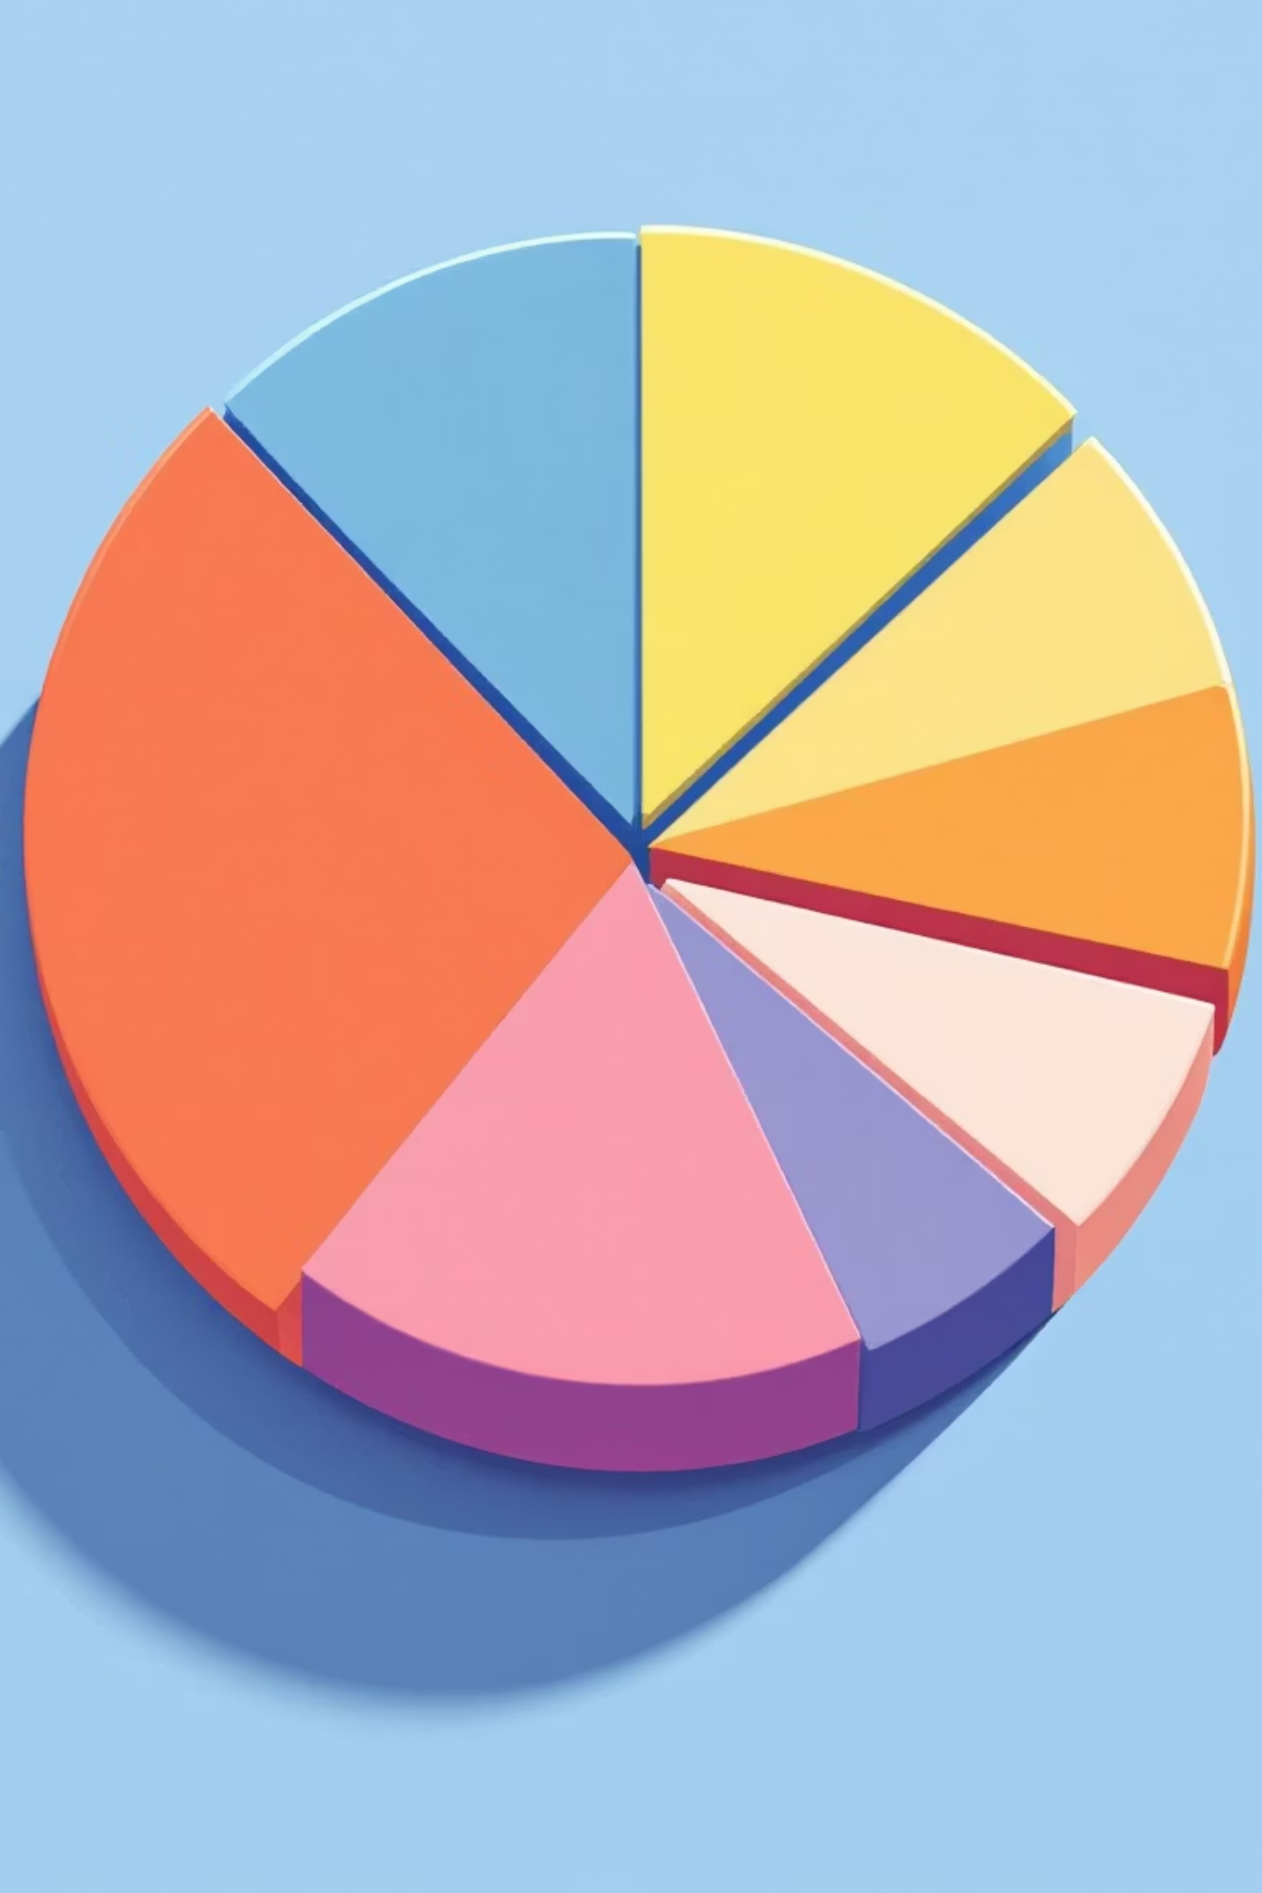
Dataset: Hugging Face Emotion Collection
Our training foundation consists of 20,000 annotated tweets spanning six emotion categories. The balanced distribution across classes ensures the model learns robust representations for each emotion.
16K
2K
2K
Training
Validation
Test
Core examples for model learning
Development set for tuning
Held-out for final evaluation
6
Classes
Joy, sadness, anger, fear, love, surprise

Slide 5

Model Architecture and Methodology
DistilBERT serves as our foundation—a distilled, faster variant of BERT maintaining 97% of performance with 40% fewer parameters. We employ standard NLP preprocessing and leverage Hugging Face's Trainer API for efficient fine-tuning.
Preprocessing Pipeline
Fine-Tuning Setup
Tokenization with DistilBERT tokenizer
Hugging Face Trainer API
Cross-entropy loss function
Max sequence length: 128 tokens
Adam optimizer for weight updates
Automatic padding and truncation
Validation metrics: accuracy and F1
Numerical label encoding

Slide 6

Hyperparameter Optimization: Optuna Search
We conducted systematic hyperparameter optimization using Optuna, testing combinations of learning rate, batch size, and training epochs. This rigorous search yielded substantial performance improvements.
Learning Rate
1
4.7e-05 optimal for stable convergence
Batch Size
2
16 balances gradient stability and memory
Epochs
3
3 epochs prevents overfitting while achieving convergence
Result
4
F1 score of 0.908 with optimal configuration

Slide 7




Performance: Baseline vs. Fine-Tuned
The fine-tuned DistilBERT demonstrates substantial improvements across all metrics. The 8% accuracy gain and 0.08 F1-score improvement validate our optimization approach and demonstrate the model's enhanced emotion discrimination capability.
83%
91%
Baseline Accuracy
Fine-Tuned Accuracy
0.82
0.90
Baseline F1
Fine-Tuned F1

Slide 8
Error Analysis: Where the Model Struggles
Examining misclassifications reveals patterns. Sarcastic and mixed-emotion sentences present the greatest challenge, as they require contextual and pragmatic understanding beyond surface-level text.
Example
True Label
Prediction Error
"I'm so angry I could laugh"
Anger
Classified as joy (sarcasm)
"Sadly happy to see you go"
Sadness
Confused with mixed sentiment
"This weather scares me... not"
Fear
Missed irony detection
Key insight: Integrating multi-emotion labels and contextual datasets would address these edge cases.

Slide 9



Inference Pipeline in Action
The fine-tuned model is production-ready. Below are real predictions across all six emotion categories, demonstrating confident and accurate emotion recognition from natural language input.
Joy
Sadness
Anger
Input: "I'm so happy today!"Confidence: 0.98
Input: "I feel so alone"Confidence: 0.95
Input: "This is outrageous!"Confidence: 0.92

Slide 10

Conclusion and Future Directions
We successfully fine-tuned DistilBERT for emotion detection, improving F1 from 0.82 to 0.90. The model demonstrates strong generalization and is deployment-ready.
Next: PEFT and LoRA
Implement parameter-efficient fine-tuning for resource-constrained deployment
Multi-Label Support
Handle texts expressing multiple simultaneous emotions
Streamlit Deployment
Build interactive web interface for real-time inference
Ethical Framework
Ensure bias mitigation and responsible AI deployment practices

